Slide 1

WorldWide Importers Analysis

Slide 2


STORY BEHIND PROJECT

Slide 3
Database Description
The Worldwide Importers Data is a B2B dataset provided by Microsoft for training, testing, and demonstrating data management, data analysis, and reporting solutions covering areas such as:
Sales
Regions
Customers(Business)
Suppliers
Payment Methods
And more

Slide 4
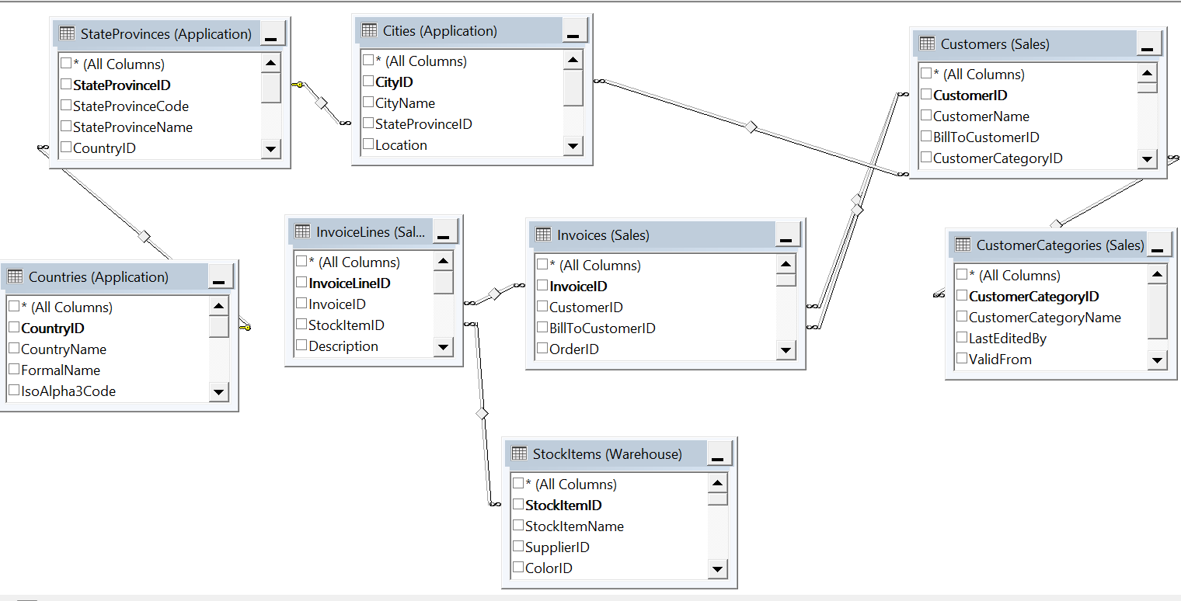
Data Warehouse Construction
Not every table included in the analysis , so we had to choose only 8 tables from 20+ table in the database covering Invoices, customers ,regions and products.

Slide 5
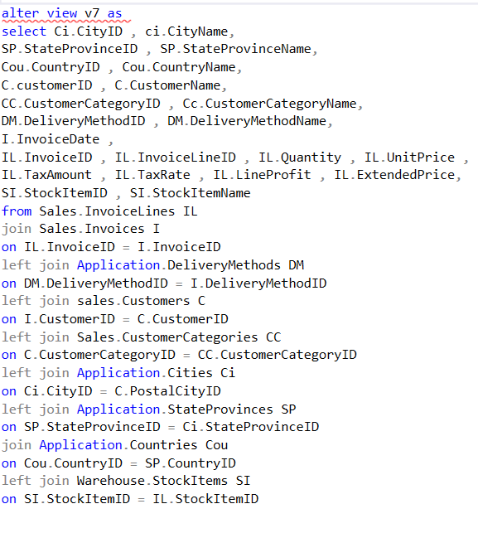
SQL DATA EXTRACTION

Slide 6
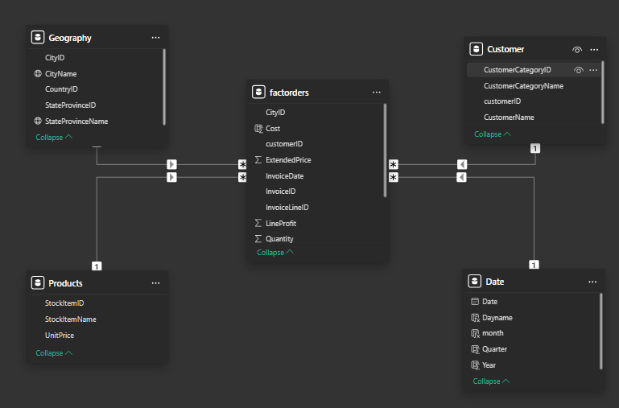
Star Schema

Slide 7

Dataset Overview
After the star schema construction, we have 5 tables:
Customers(Dimension)
Geography(Dimension)
Date(Dimension)
Stock(Dimension)
Orders(fact)

Slide 8
Dimensions
Customers table consists of two information: Customer name(business) , Customer Type(Business type)
Stock: Table consist of the products that worldwide importers supplies to the companies
Date Dimension: Table is generated from the order date column in the Orders fact table
Geography: Worldwide importers data covers all the US states(49) and 665 city

Slide 9
Fact
Orders: table is the fact table that connects all the data warehouse with the Sales.
It consists of all keys that connects with the dimension tables and some measures like unit price, units sold, Cost , Sales , profit

Slide 10

Business Questions and Key Areas Analysis
We focused on:
Overall Performance & Profitability
Show KPIs: Total Sales, Quantity, Orders and Profit margin and Other KPIs that show overall performance
Customer Behavior Sales Analysis
Which customer segment (e.g., supermarket, corporate, computer store, gift store, novelty shop) is generating the highest revenue and profit?
What are the purchasing patterns for top customer categories over the year?
Product Sales Analysis: Top and Bottom 10 by Quantity and Sales for each segment
Regional Sales Analysis:
Which states are leading in sales, and what is the growth trend across different geographic areas?
Are there underperforming states with growth potential, and what strategies could be employed to drive engagement in these areas?

Slide 11
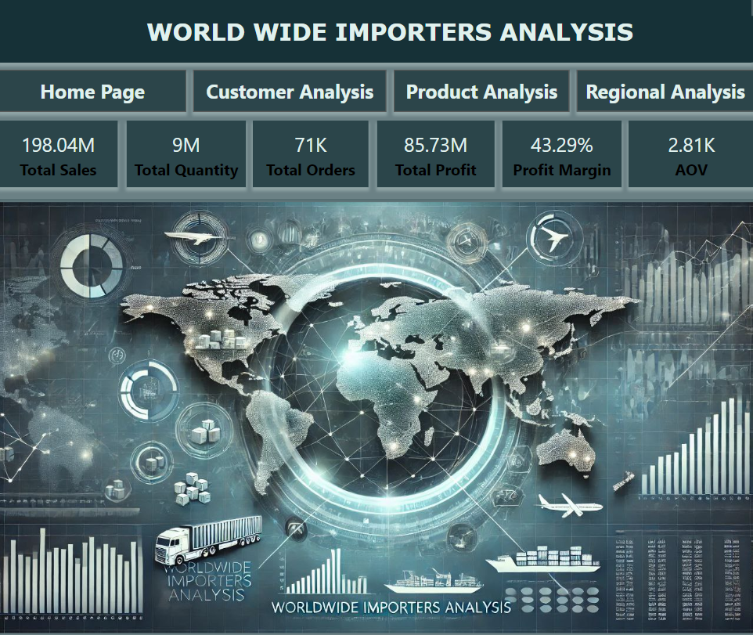

Slide 12

Overview
KPIs:
Total Sales: $198.04M
Total Quantity Sold: 9M units
Total Orders: 71K
Total Profit: $85.73M
Profit Margin: 43.29%
Average Order Value (AOV): $2.81K
Average Quantity Per Order: 127 item
Insights:
A healthy profit margin (43.29%) indicates efficient cost management or high-value products.
The high average order value suggests the business may cater to bulk purchasers and B2B customers rather than individual consumers as we talk before
With substantial total orders and quantities, this business operates on a large scale, suggesting widespread distribution channels.

Slide 13
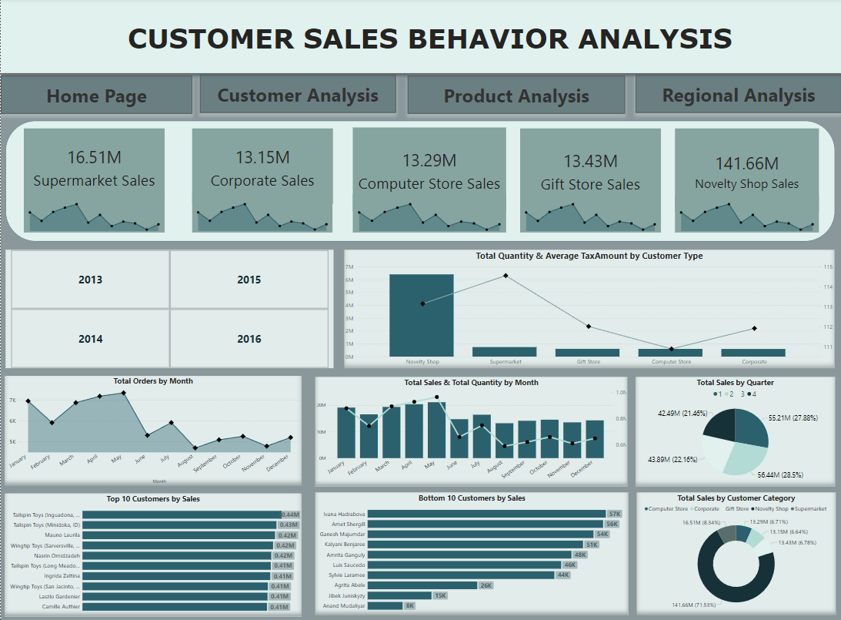

Slide 14
Customer Sales Behavior Analysis
Overview:
Sales by Category:
Supermarket: $16.51M
Corporate: $13.15M
Computer Store: $13.29M
Gift Store: $13.43M
Novelty Shop: $141.66M (highest)
Monthly Trends:
Orders and sales peak in certain months, with noticeable declines around September and November.
Highest sales are observed in the first and second quarters, particularly in Q2.
Top Customers by Sales:
Includes customers like Tailspin Toys and Wingtip Toys, indicating potential key accounts.
Insights:
The Novelty Shop segment dominates sales, highlighting a strong market presence in unique or specialty items.
Fluctuating monthly sales indicate potential seasonal demand, suggesting the need for stock adjustments and marketing alignment during peak seasons.
Key accounts drive significant revenue, making them crucial to maintain through personalized service or exclusive offers.
Recommendations:
Increase marketing efforts in high-sales months and consider discounts in low-demand periods to smooth revenue.
Invest in CRM strategies for top customers to encourage repeat purchases.
Conduct further analysis on the Novelty Shop category to identify why it outperforms others and replicate its success in other segments.

Slide 15
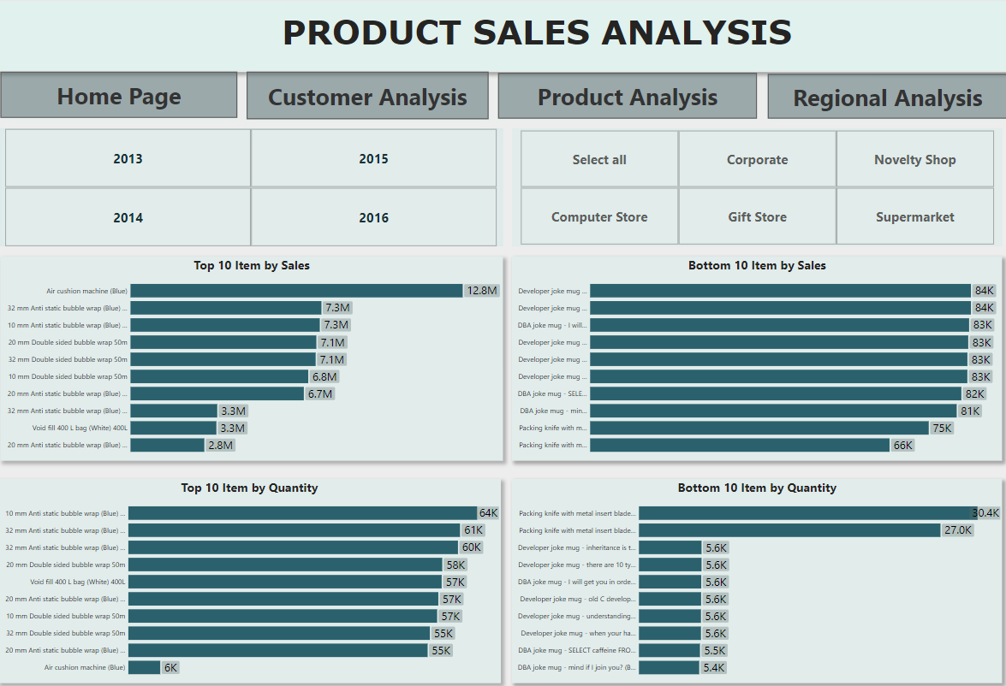

Slide 16
Product Sales Analysis
Overview:
Top-Selling Products:
Air Cushion Machine: $12.8M
Various bubble wrap items are also top sellers, suggesting a focus on packaging supplies.
Bottom-Selling Products:
Items like developer joke mugs have lower sales, with a maximum of $84K.
Top Products by Quantity:
Bubble wrap items dominate both in sales and quantity, indicating their high demand.
Insights:
Bubble wrap and air cushion machines are essential products, likely due to demand in packaging, potentially for e-commerce or logistics industries.
Lower-selling items, like novelty mugs, have limited appeal, suggesting these are niche products or poorly marketed.
Recommendations:
Continue focusing on high-demand packaging products and explore expanding the line to similar items.
For low-selling novelty items, consider targeted marketing to reach the appropriate customer base or bundle these with other products to increase sales.
Streamline inventory by reducing quantities of slow-moving products and reallocating resources to top sellers.

Slide 17
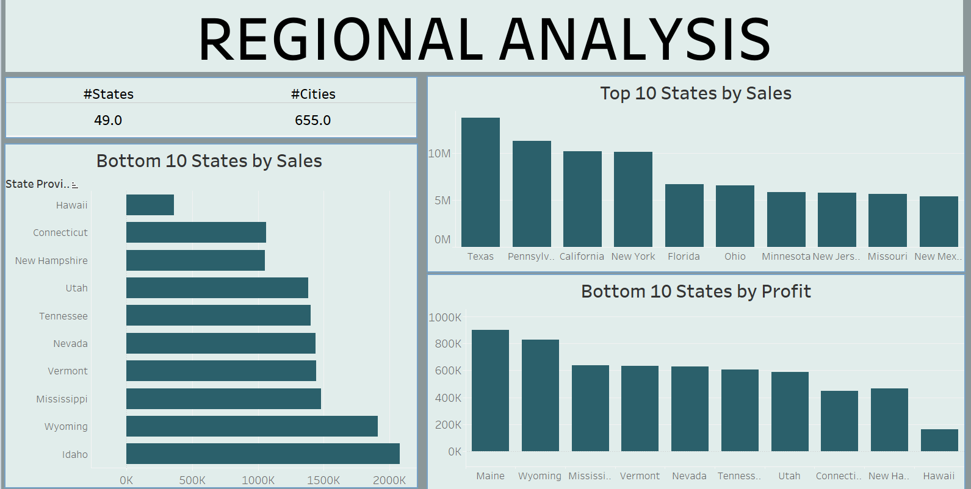

Slide 18
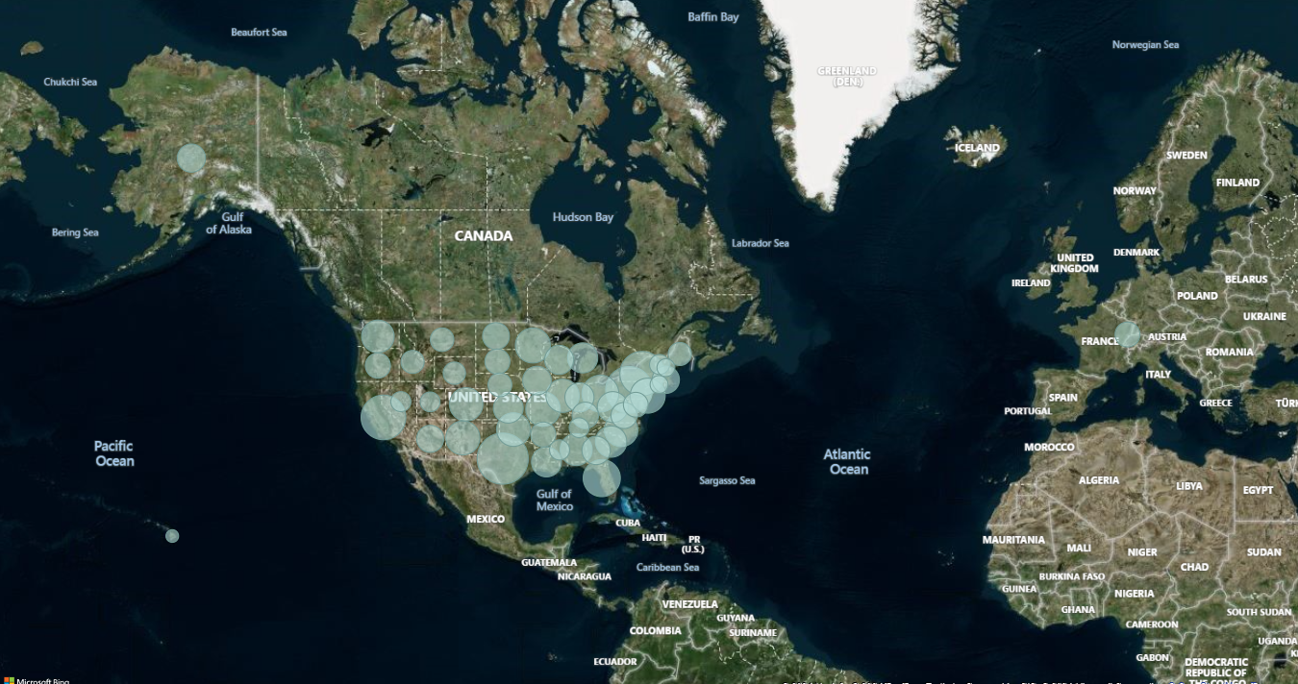

Slide 19
Regional Analysis
There are 9 states and 655 cities, which is a wide geographic coverage, indicating a broad analysis of regional performance.
Hawaii is the bottom state by sales and that can be explained by that Hawaii is a small state with only few cities
Texas is the top state by Sales with more than 12M Sales
Hawaii is the bottom state by sales
There is no negative values which is so good for Worldwide importers company
Sales distribution by state, bubble size represent the Sales

Slide 20


